Slide 1


Titolo presentazione sottotitolo
Multi-Task Feature Selection for Drought Monitoring:
a conditional mutual information approach
Milano, XX mese 20XX
Candidate: Lorenzo Nardi
Supervisor: Prof. Marcello Restelli
July 22, 2022

Slide 2
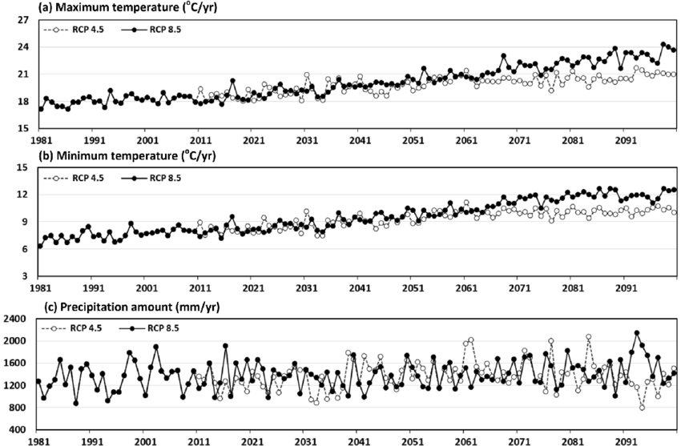
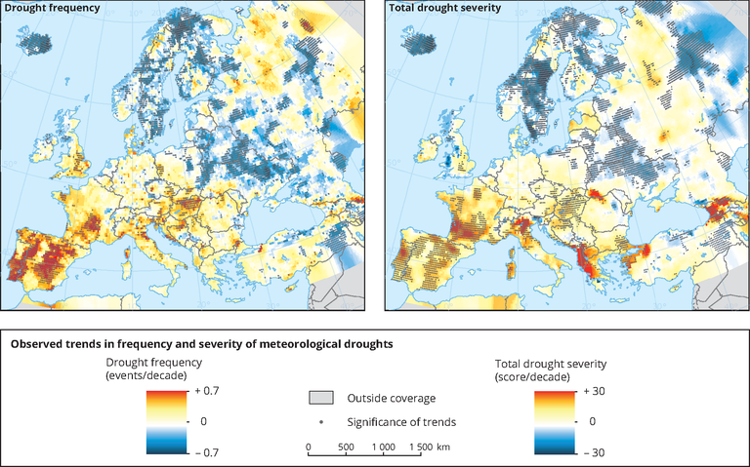
Motivations and Goals
Motivations
Climate change effects increase droughts frequency
Severe drought impact on food growth and economy
Goals
Identify drought drivers on large and heterogeneous geographical areas
Multi-Task Learning for parallel drought monitoring
Credits for images: eea.europa.eu

Slide 3
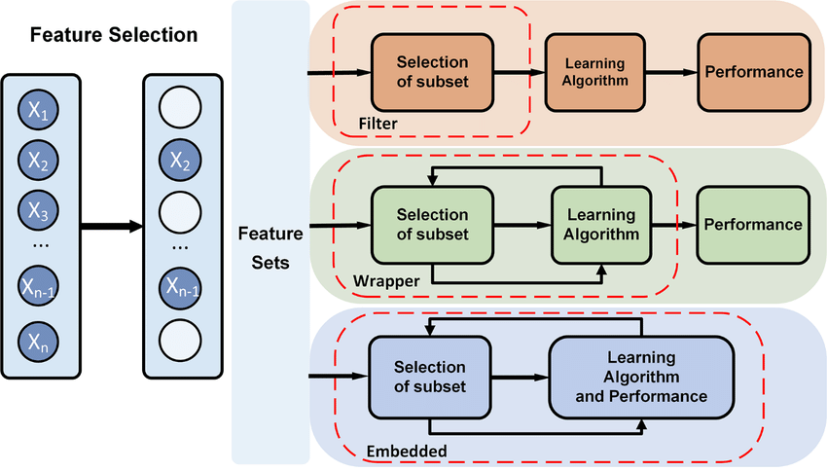
Feature Selection approaches
Credits for images: Xie, L.; Li, Z.; Zhou, Y.; He, Y.; Zhu, J. Computational Diagnostic Techniques for Electrocardiogram Signal Analysis. Sensors 2020, 20, 6318. https://doi.org/10.3390/s20216318

Slide 4
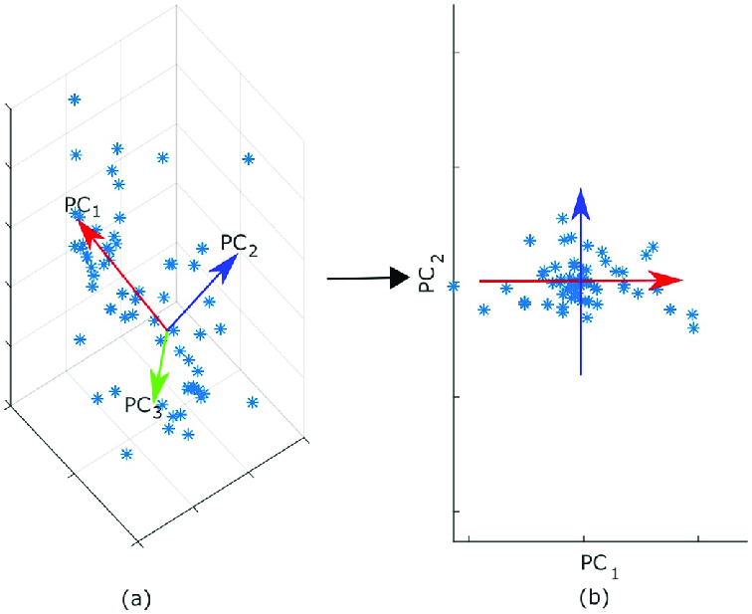
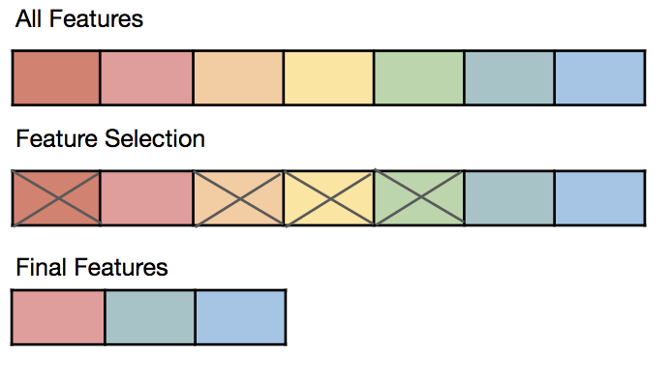
Adopted approach for dimensionality reduction
Dimensionality reduction with PCA
Reducing dimensionality by combination of features
More efficient computational cost
Feature Selection
Identification of relevant and non-redundant set of features to learn a given task
Filter-based approach [4], ranking features according to Conditional Mutual Information scores
Credits for images: Migenda, Nico, Ralf Möller, and Wolfram Schenck. "Adaptive dimensionality reduction for neural network-based online principal component analysis." PloS one 16.3 (2021): e0248896. ,
Farsi, Mohammed. "Filter-Based Feature Selection and Machine-Learning Classification of Cancer Data." INTELLIGENT AUTOMATION AND SOFT COMPUTING 28.1 (2021): 83-92.

Slide 5
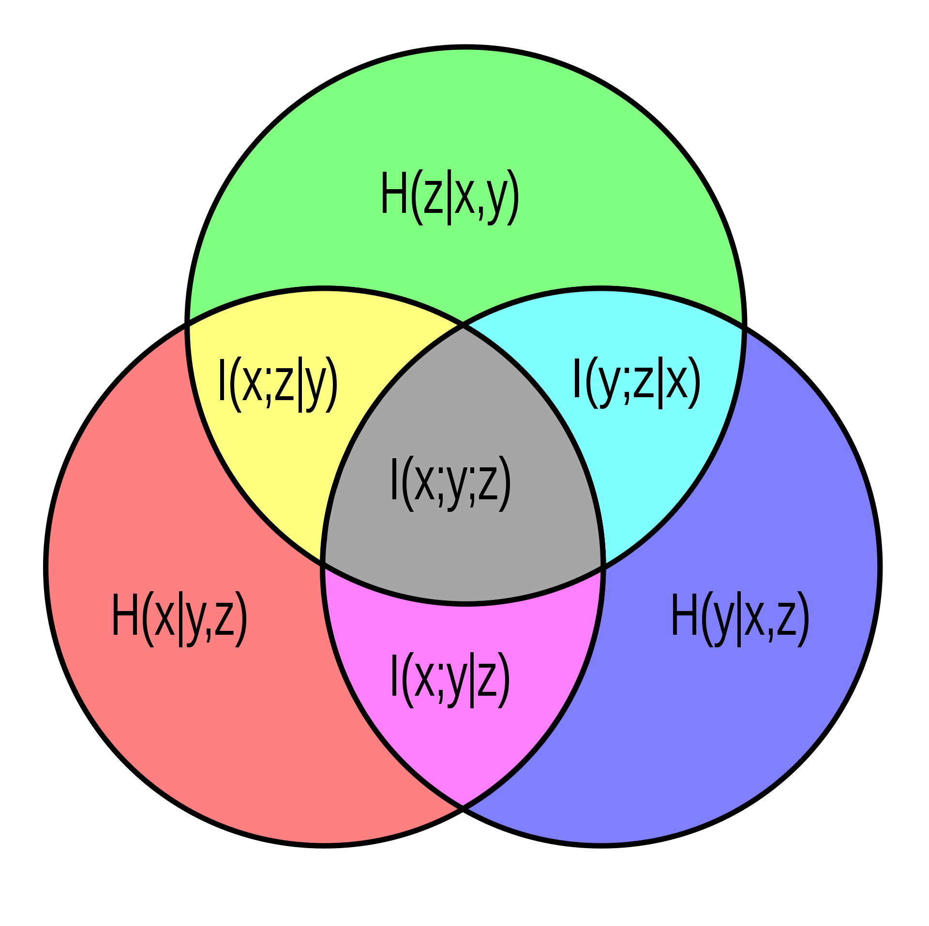
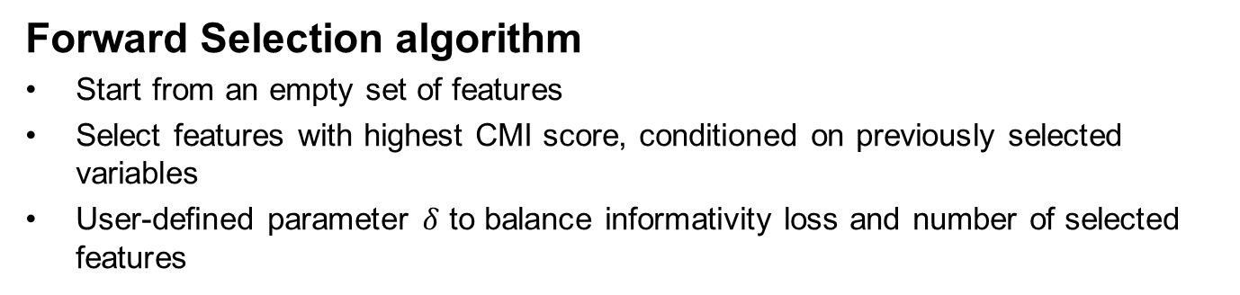
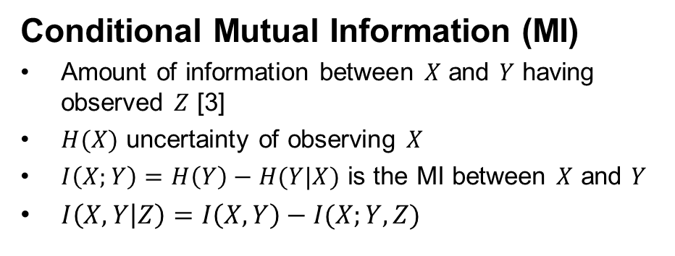
Feature Selection with Conditional Mutual Information
Conditional Mutual Information (MI)
Amount of information between $X$ and $Y$ having observed $Z$ [3]
$H(X)$ uncertainty of observing $X$
$I\left(X;Y\right)=H\left(Y\right)−H(Y|X)$ is the MI between $X$ and $Y$
$I\left(X,Y | Z\right)=I\left(X,Y\right)−I(X;Y,Z)$
Forward Selection algorithm
Start from an empty set of features
Select features with highest CMI score, conditioned on previously selected variables
User-defined parameter $δ$ to balance informativity loss and number of selected features
Credits for images: en.wikipedia.org

Slide 6

Supervised Learning
Drought monitoring
Detection of drought conditions through variables obtainable in near real-time
Two Supervised Learning approaches
Reconstruction of a drought index estimating a continuous value from selected inputs
Classification of cultivable soil conditions
Credits for images: univ-orleans.fr

Slide 7
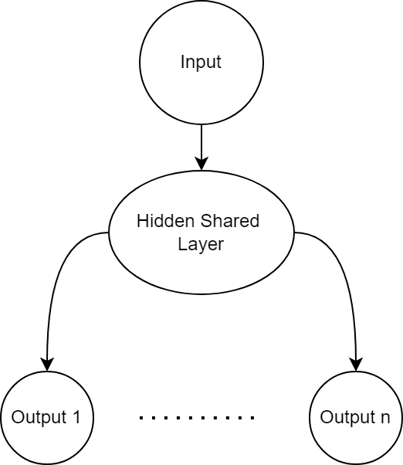
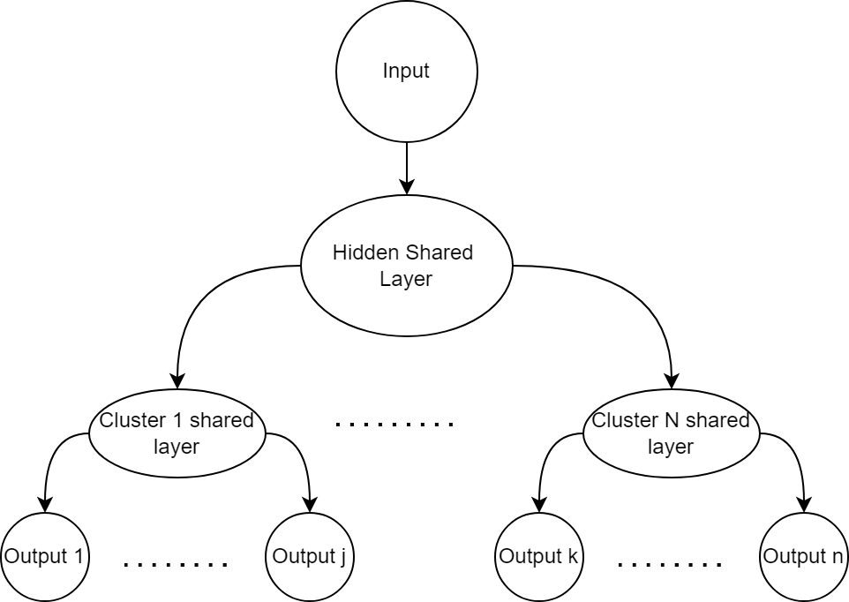
Multi-Task Supervised Learning
Model trained to simultaneously learn different tasks
Improve generalization by leveraging knowledge from one task to another
Parameter-based approach [5]

Slide 8
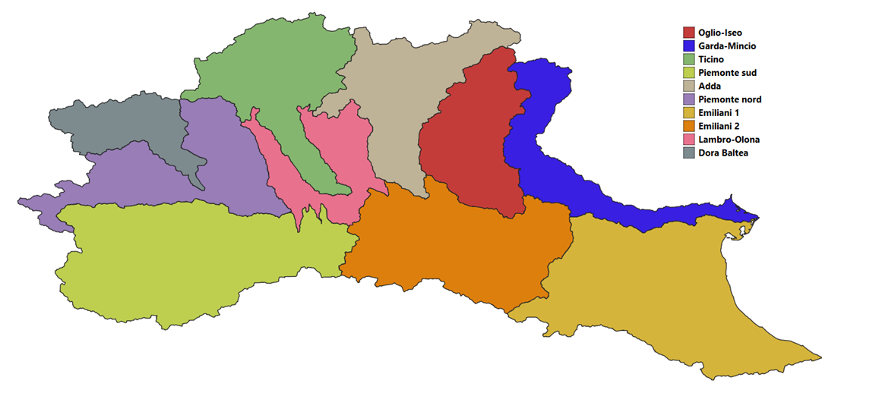
Case study area
Ten main hydrological sub-basins identified in the Po Valley region
Different geographical characteristics, all crossed by Po river
Potentially correlated drought drivers

Slide 9
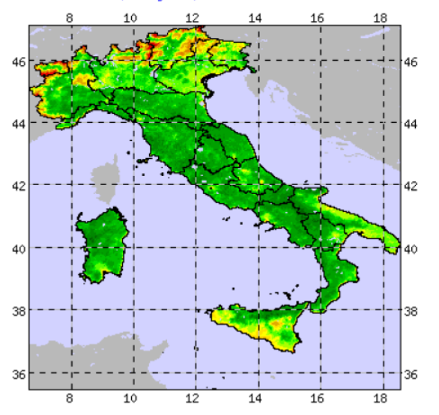
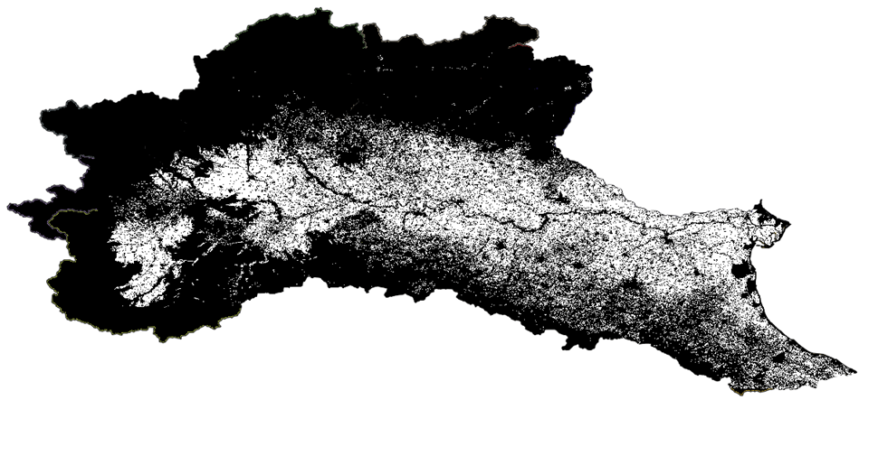
Target variable: NDVI anomaly
Normalized Difference Vegetation Index
Index of vegetation health by assessing the amount of solar radiation absorbed by green leaves
The target is the signal deviation from the average value in a week
Target extracted for cultivable areas only
Availability 2000-2021

Slide 10
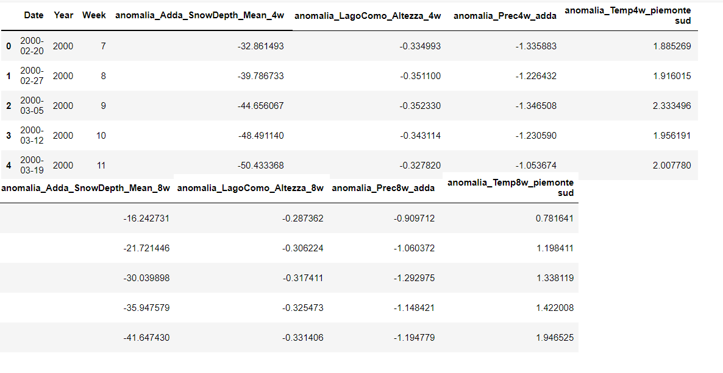
Input variables
Average temperature and precipitation in each of the sub-basins
Average snow depth cover for every sub-basin
Average lakes water levels
Aggregated over 4, 8, 12, 16, 24 weeks, from 2000 to 2020

Slide 11
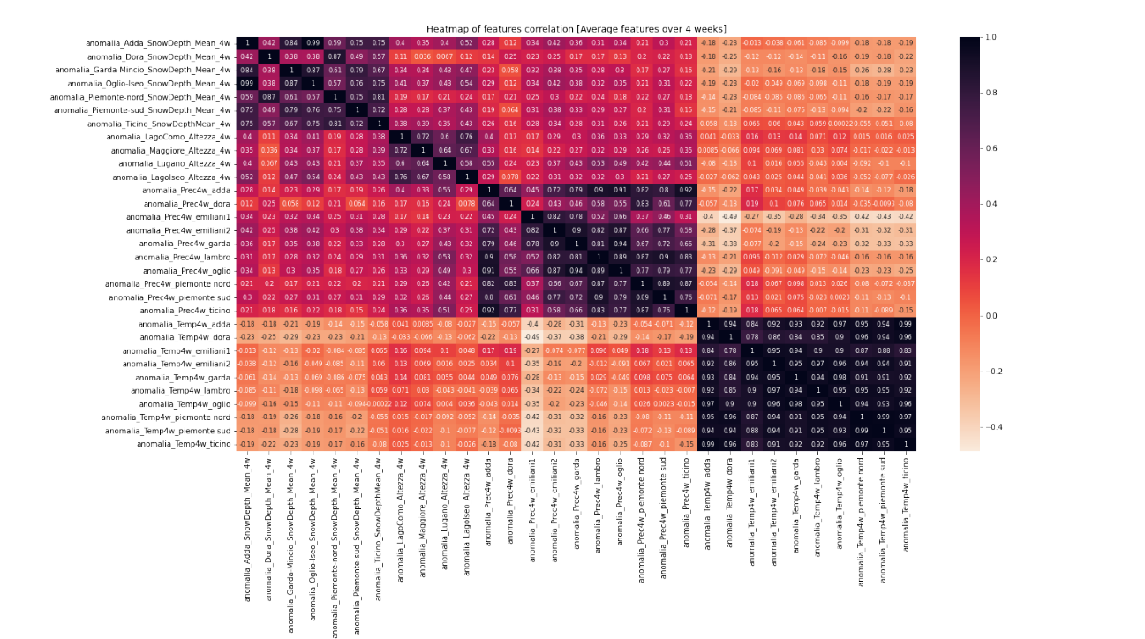
Dimensionality reduction with PCA

Slide 12
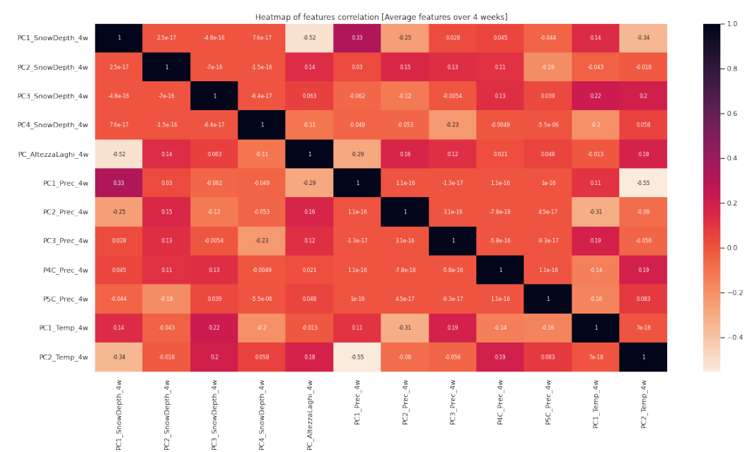
Dimensionality reduction with PCA

Slide 13
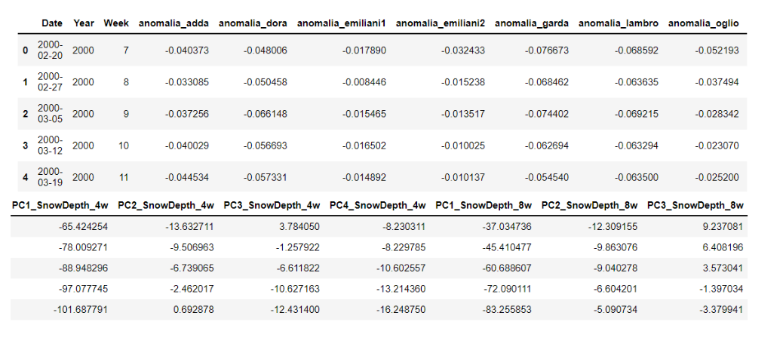
Final dataset
From 1038 × 154 to 1038 × 60 (excluding target and temporal indicators)
Notes:
Localizzazione geografica variabili persa

Slide 14
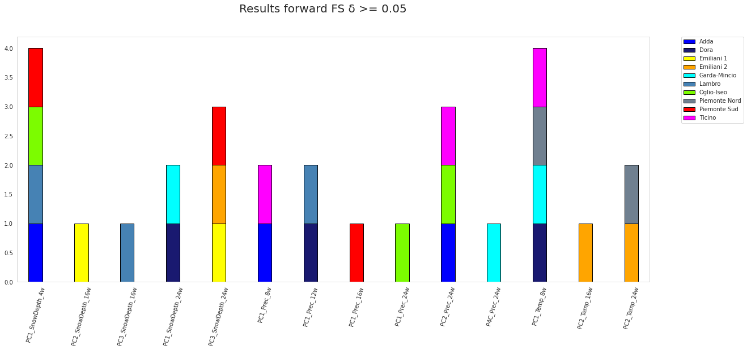
Results – Single-Task Feature Selection
Notes:
* Da 60 -> 10, molte sono in commune tra tutte, alcune mantegono pecuilarità

Slide 15
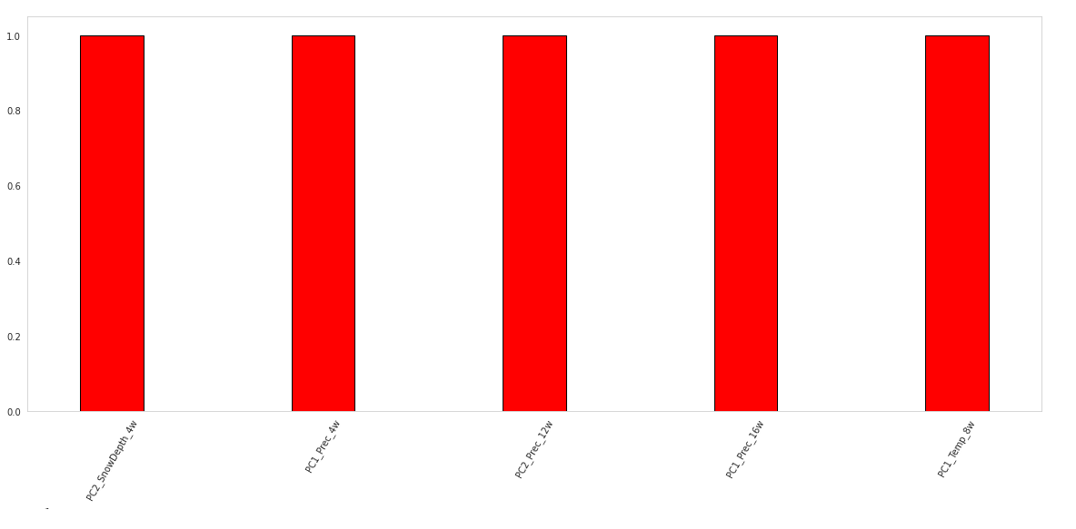
Results – Multi-Task Feature Selection

Slide 16
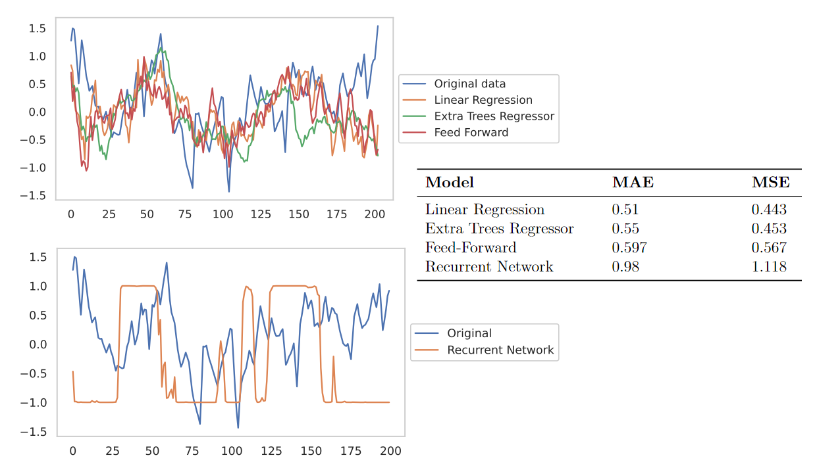
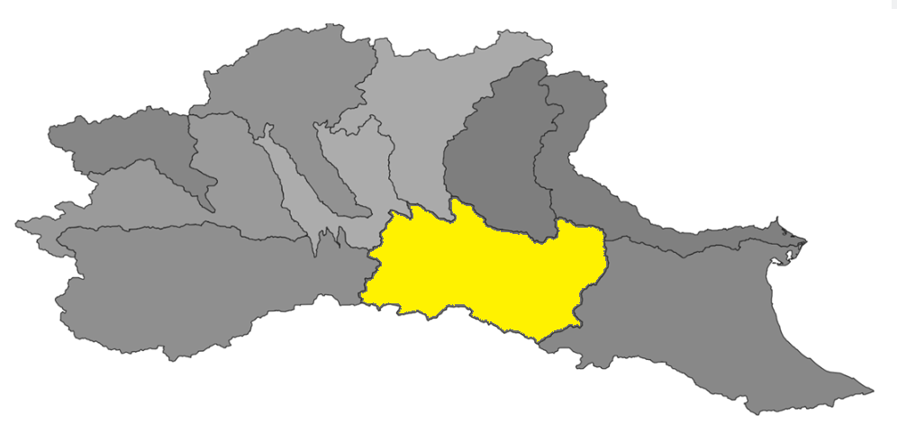
Results – Single-Task models
Notes:
Il target può anche essere visto come un segnale autoregressivo del terzo ordine

Slide 17
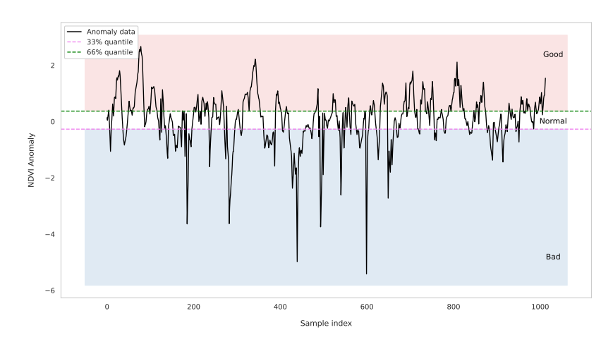
Results – Classification labels
Classification approach: definition of labels from data

Slide 18
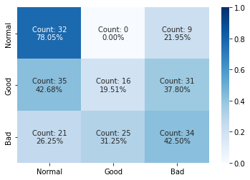
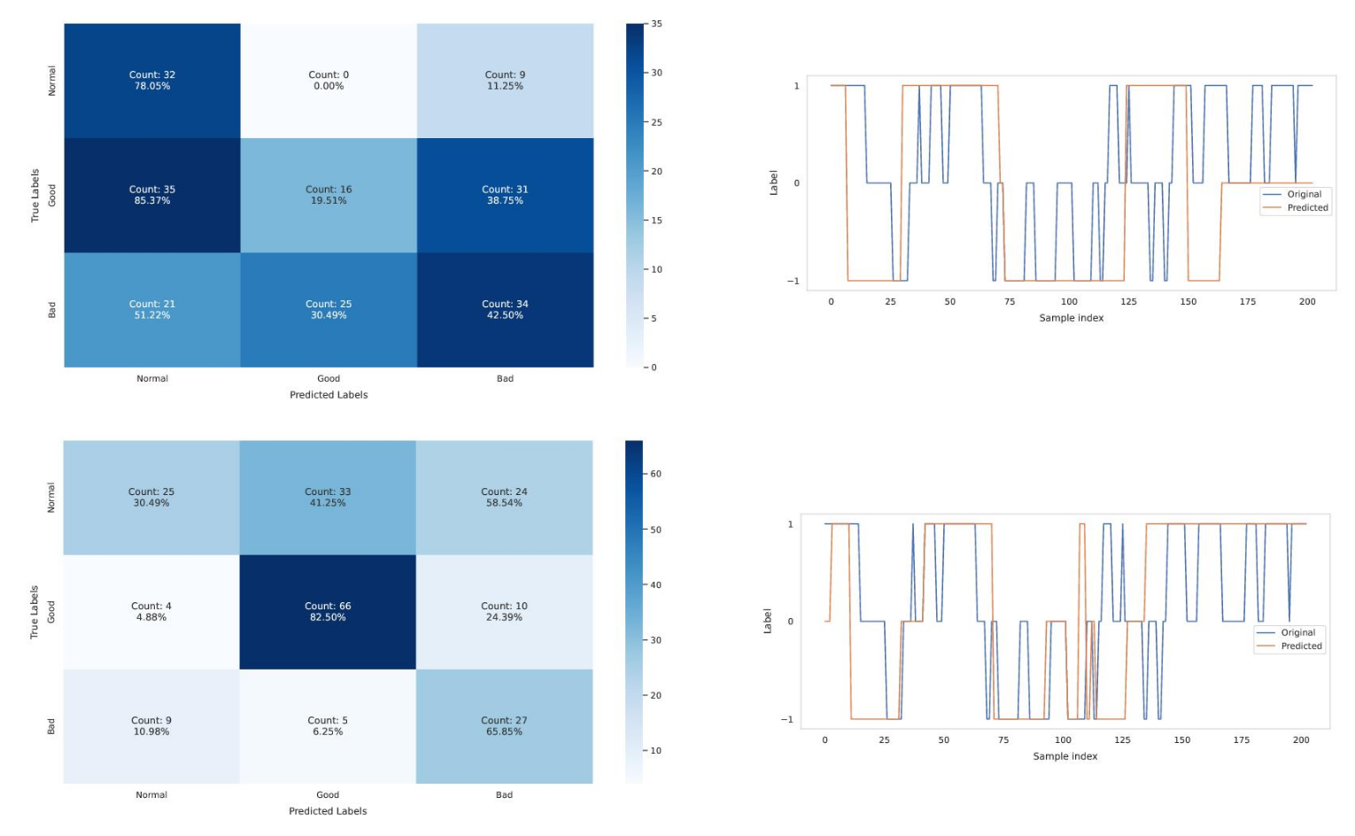
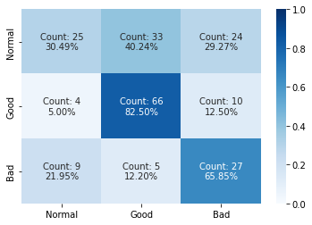
Results – Single-Task models
Extremely Randomized Trees
Feed-Forward Neural Network

Slide 19
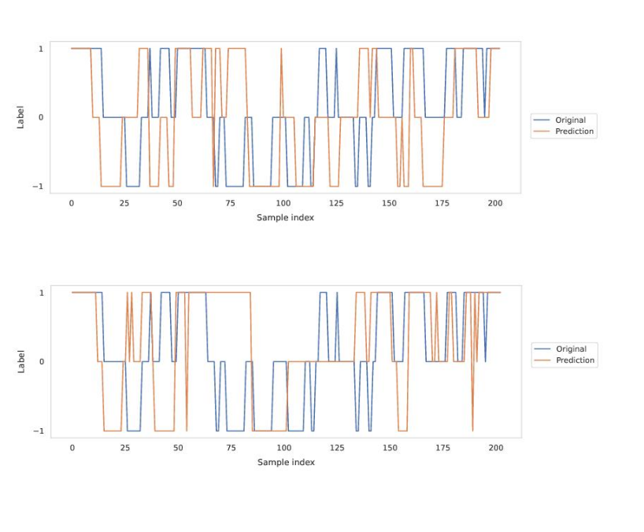
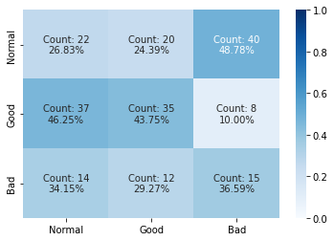
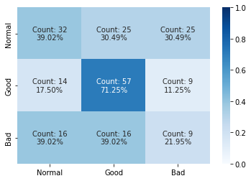
Results – Multi-Task models
Single hidden shared layer Feed-Forward Network
Task clustering Recurrent Neural Network

Slide 20
Conclusions and Improvements
Conclusions
Good classification results
Multi-Task models are able to generalize over the ten sub-basins despite limited and noisy data
Improvements
Introduce area-specific features
Introduce variables to consider urbanization effects on drought conditions
Multi-Task drought monitoring through classification based on different drought index in parallel (e.g., NDRE, MSAVI etc.)
Notes:
Normalized Difference Red Edge Vegetation Index -> maturity
Modified Soil-Adjusted Vegetation Index -> early stage
NDVI -> intermediate growth state

Slide 21
Bibliography
[1] Marta Zaniolo, Matteo Giuliani, Andrea Francesco Castelletti, and Manuel, Pulido-Velazquez. Automatic design of basin-specific drought indexes for highly regulated water systems. Hydrology and Earth System Sciences, 22(4):2409–2424, 2018.
[2] Ron Kohavi and George H John. Wrappers for feature subset selection. Artificial intelligence, 97(1-2):273–324, 1997.
[3] Gavin Brown, Adam Pocock, Ming-Jie Zhao, and Mikel Luján. Conditional likelihood maximisation: a unifying framework for information theoretic feature selection. The journal of machine learning research, 13(1):27–66, 2012.
[4] Mario Beraha, Alberto Maria Metelli, Matteo Papini, Andrea Tirinzoni, and Marcello Restelli. Feature selection via mutual information: New theoretical insights. In 2019 International Joint Conference on Neural Networks (IJCNN), pages 1–9. IEEE, 2019.
[5] Yu Zhang and Qiang Yang. A survey on multi-task learning. IEEE Transactions on Knowledge and Data Engineering, 2021.

Slide 22
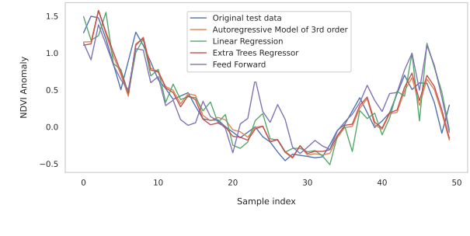
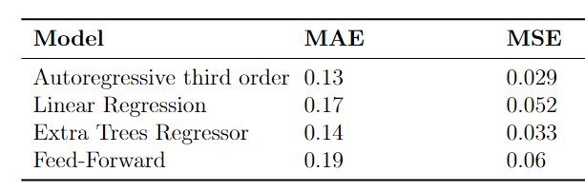
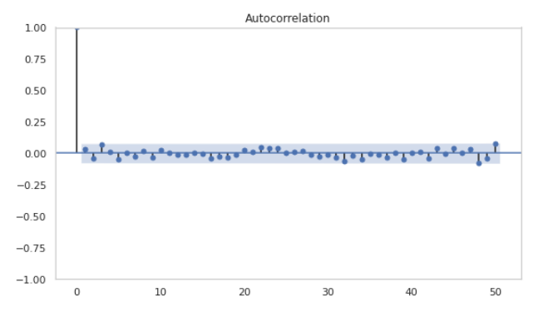
Additional Content – AR prediction

Slide 23
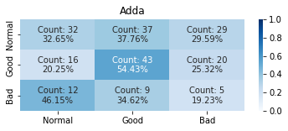
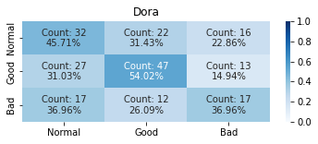
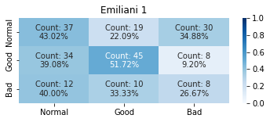
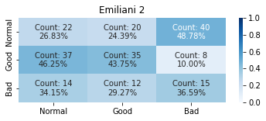
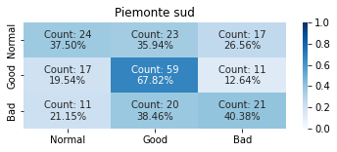
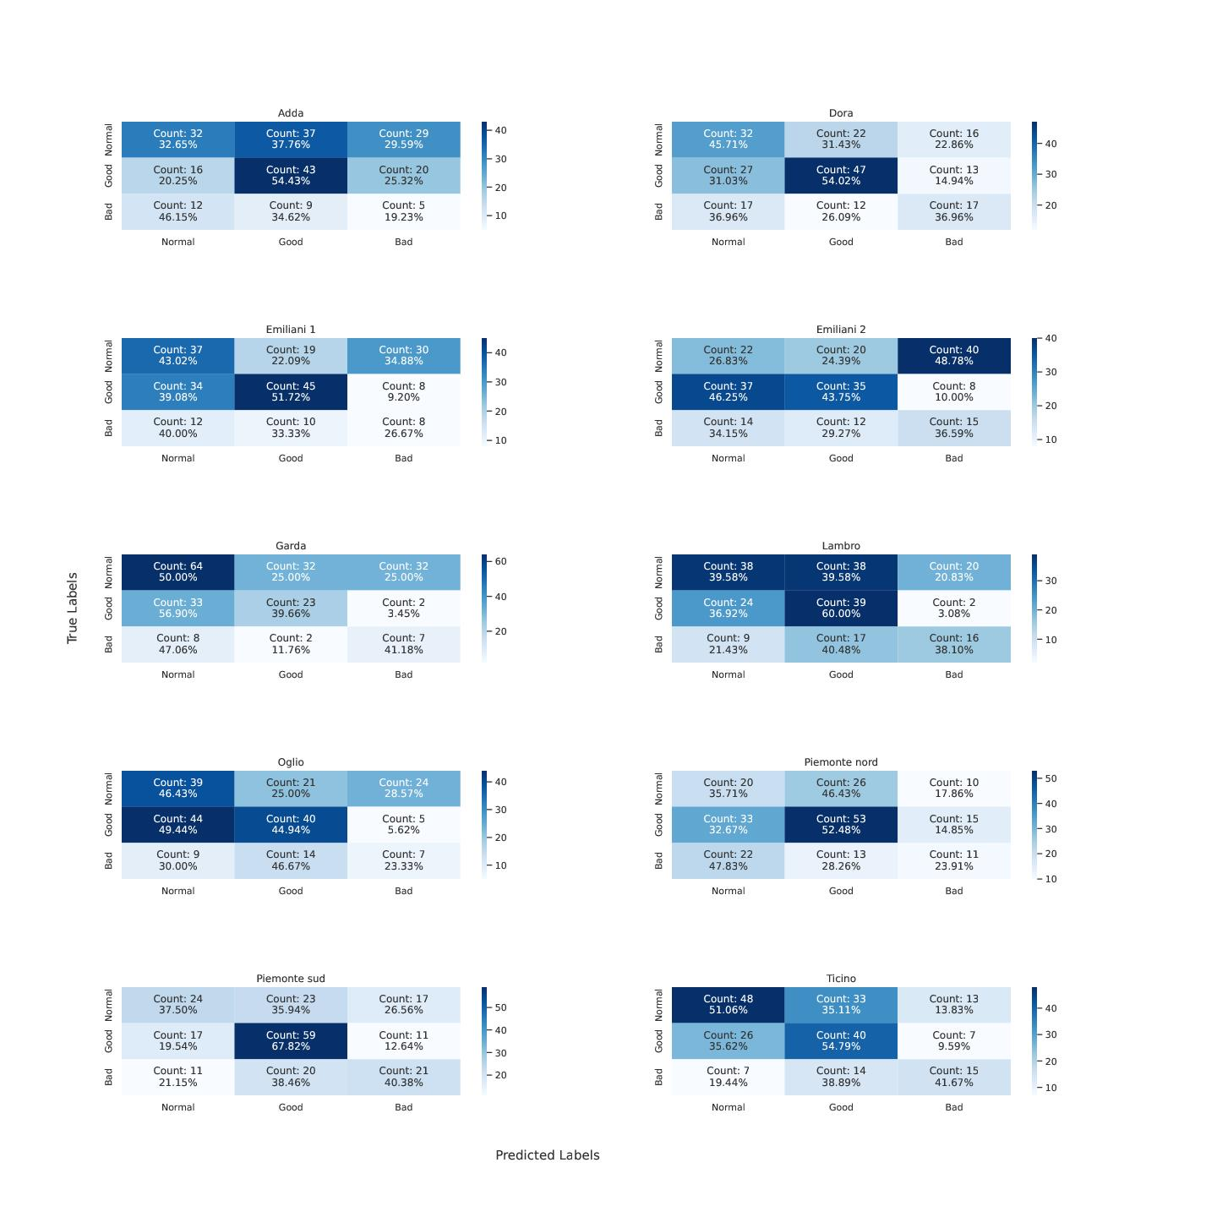
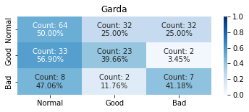
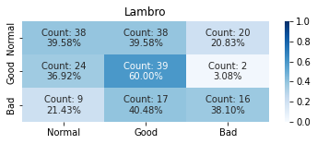
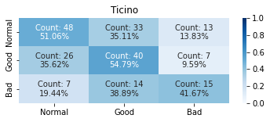
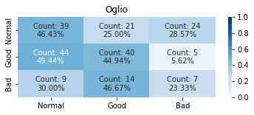
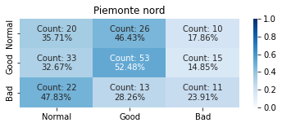
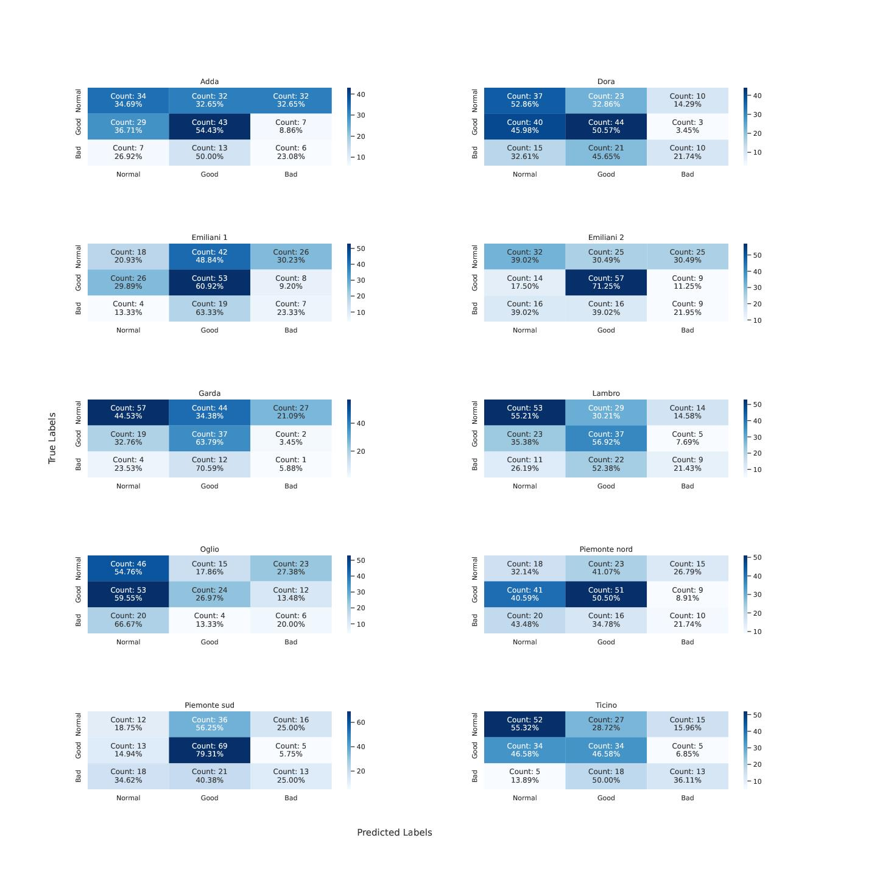
Additional Content – MT Feed-Forward results

Slide 24
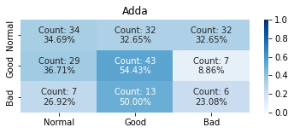
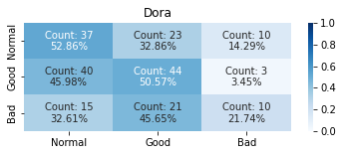
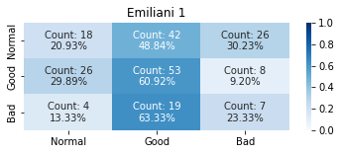
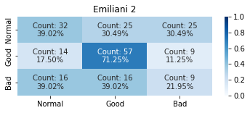
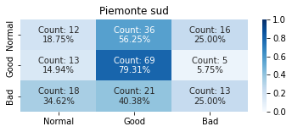
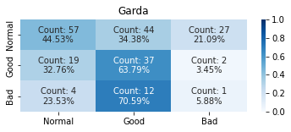
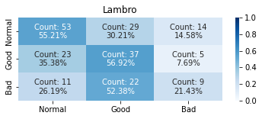



Additional Content – MT Recurrent results

